Slide 1
Part 7: Virtual Memory
Introduction
  Swapping, Virtual Memory Support
Demand Paging
  Page Fault, Performance of Demand Paging, Page Replacement
Page-Replacement Algorithms
  FIFO, Optimal, LRU, LRU Implementation, and LRU Approximation
Allocation of Frames
  Fixed vs. Variable Allocation, Local vs. Global Replacement
Thrashing
  Cause of Thrashing, Working-Set Model, Page-fault Frequency Scheme
Notes:
Part 6 introduced the concepts of paging and segmentation and analyzed their shortcomings. We now move to a discussion of virtual memory. An analysis of this topic is complicated by the fact that memory management is a complex interrelationship between processor hardware and operating system software. We first look at why virtual memory is necessary and illustrate VM by using demand paging. Then we focus on some design issues involved in VM support (page replacement policies and frame allocation policies) and issues related to performance (thrashing).

Slide 2
Introduction - Swapping
A process can be swapped temporarily out of memory to a backing store, and then brought back into memory for continued execution
Backing store – fast disk large enough to accommodate copies of all memory images for all users; must provide direct access to these memory images
Major part of swap time is transfer time; total transfer time is directly proportional to the amount of memory swapped
Swapping can be used to
  Make space available for processes that require more memory
  Increase the degree of multiprogramming (i.e., medium term scheduler)
Notes:
Processes in waiting or ready state can be swapped out
A ready queue can consists of processes whose image is either in memory or in backing store
Context-switch time in such swapping system is fairly high
*swapping is for the entire process image.

Slide 3
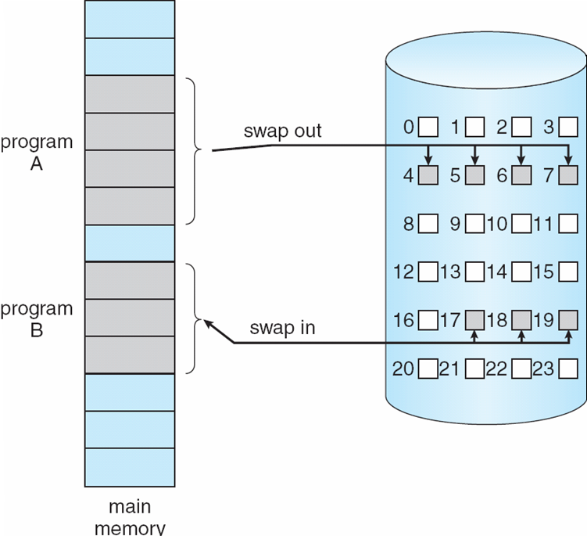
Introduction – Swapping (cont.)
process
A
process
B
backing
store
physical
memory
Notes:
A process may be swapped in and out of main memory such that it occupies different regions of main memory at different times during the course of execution <- relocatable code
After swapping out, the memory frames for process A becomes available. After swapping in, the memory frames are occupied.

Slide 4
Introduction – Virtual Memory Support
So far we assumed that the whole program is loaded into the memory, at least at some point of time.
Restriction: Overall program size, including all library routines that may be linked at runtime, must be restricted to the size of main memory
To remove this restriction, the logical memory size requirement of the user program must be de-coupled from the size of the physical memory space
This is what virtual memory aims to achieve
  The size of virtual memory is limited by the address scheme of a computer, not by the actual size of the physical memory.
Notes:
Although swapping (and some other techniques) can be used to make space available for processes that require more memory and to increase the degree of multiprogramming, fundamentally the whole process image is still required to be loaded into the memory at least at some point of time.
Decoupled= independent

Slide 5
Introduction – Virtual Memory Support (Cont.)
page 0
page 1
page 2
page 2
.
.
.
.
.
.
n pages
m frames
page 1
page i
.
.
.
.
.
.
page table
physical
memory
page n-1
logical
memory
n > m
Notes:
Then, if the program branches to an instruction or references a data item on a page not in main memory, a fault is triggered. This tells the operating system to bring in the desired page.
Thus, the size of virtual memory is limited by the address scheme of a computer, not by the actual size of the physical memory.
%%%more details%%%
To understand what the key issue is, and why virtual memory was a matter of much debate, let us examine again the task of the operating system with respect to virtual memory. Consider a large process, consisting of a long program plus a number of arrays of data. Over any short period of time, execution may be confined to a small section of the program (e.g., a subroutine) and access to perhaps only one or two arrays of data. If this is so, then it would clearly be wasteful to load in dozens of pages for that process when only a few pages will be used during that stage of process execution. We can make better use of memory by loading in just a few pages. This is possible because:
1. All memory references within a process are logical addresses that are dynamically translated into physical addresses at run time. This means that a page of a process can be in and out of main memory such that it occupies different regions of main memory at different times during the course of process’s execution.
2. A process may be broken up into a number of pieces (pages or segments) and these pieces need not be contiguously located in main memory during execution.

Slide 6
Introduction – Virtual Memory Support (cont.)
Virtual Memory Support: separation of user logical memory from the physical memory
Implications of Virtual Memory Support:
  Logical address space can be much larger than physical address space
  Only part of the program needs to be in memory for execution ⇒ greater degree of multiprogramming ⇒ increased CPU utilization
  Need to allow pages to be paged in and out
Virtual memory is implemented (mostly) using demand paging (demand segmentation is also used)
Notes:
Using virtual memory support, part of a process’ logical address space is in memory and part of it is in backing store (disk). So, logical address space can be much larger than physical address space. Since at any one time, only a few pages of any given process are in memory, more processes can be maintained in memory. Furthermore, time is saved because unused pages are not loaded in and out of memory.
For virtual memory to be practical and effective, two ingredients are needed. First, there must be hardware support for the paging scheme to be employed. Second, the operating system must include software for managing the movement of pages between memory and backing store.

Slide 7
Demand Paging
Memory requirement of a process is divided into pages
Page is needed ⇒ page reference is generated ⇒ logical address <page no., offset>
With each page table entry, a valid–invalid bit is associated
  v ⇒ in-memory, page table entry contains location of the page in memory (i.e., frame number)
  i ⇒ not-in-memory, page table entry contains the address of the page on disk
  Initially valid–invalid bit is set to i on all entries
  During address translation, if valid–invalid bit in page table entry is i ⇒ page fault (to bring the page into memory)
Notes:
Recall logical address format for paging: (page #, offset)
If valid-invalid bit in page table entry is i, the entry contains the address of the page on disk

Slide 8
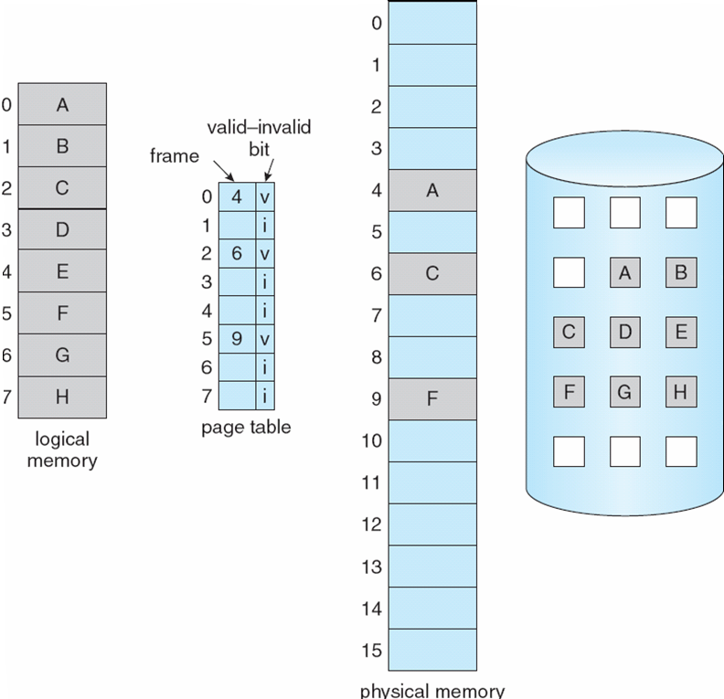
Demand Paging (Cont.)
generate a
reference to
page 6
PC
load G
backing
store

Slide 9

Page Fault
load G
k

(5.1) Modify the valid-invalid bit into valid
(5.2) Set the page table entry to be k
Notes:
5. Modify the valid-invalid bit into valid, and set the page table entry.

Slide 10
Page Fault (Cont.)
1. If there is a reference to a page, page table is checked to determine if the page is in the memory.
2. If the page is not in the memory, trap to OS to bring in the page. The state of interrupted process is saved.
3. OS uses the page table entry to locate the page in backing store.
4. OS finds a free frame (i.e., using free frame list & page replacement algorithm), and schedules a disk operation to read the desired page into the newly allocated frame.
5. When the disk read is complete, page table entry is modified.
6. The state of interrupted process is resumed, and the instruction is now re-started.


Slide 11
Performance of Demand Paging
Let p = probability of Page Fault, 0 ≤ p ≤ 1.).0
  if p = 0 no page faults
  if p = 1, every reference causes a fault
Effective Access Time (EAT)
In practice, memory access time << page fault time.
EAT = (1 – p) x memory access time
+ p x page fault time
Notes:
Effective access time = expected access time
If the system generates 10 page faults for every 100 page accesses, then p=10%.
The difference can be over 100 times.

Slide 12
Performance of Demand Paging (Cont.)
Three major components of page fault time:
  Servicing the page fault interrupt
  Read in a new page (longest component)
  Restart the process

Slide 13
Page Replacement
When page fault occurs, what happens if there is no free frame?
Solution: Find some page in memory, not really in use, and page it out for only dirty page (i.e., replace page)
If no free frame is available, then two page transfers are necessary, one out (for dirty page only) and one in. This increases further the page fault time!
Use a page replacement algorithm to locate the page to be replaced. Desirably, the algorithm should result in minimum number of page faults

Slide 14
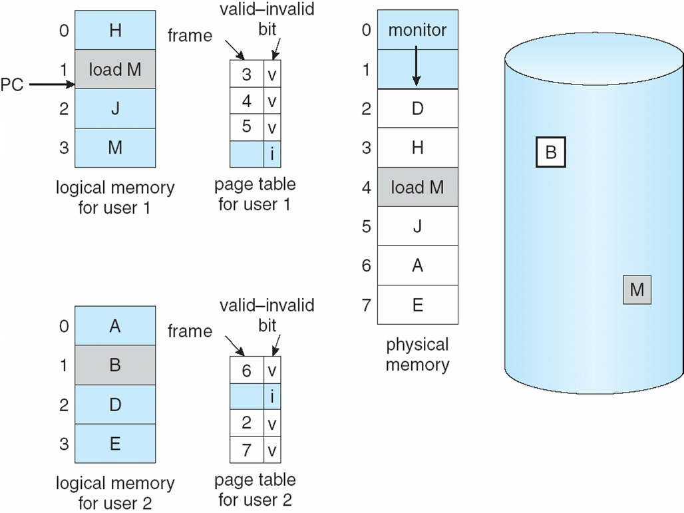
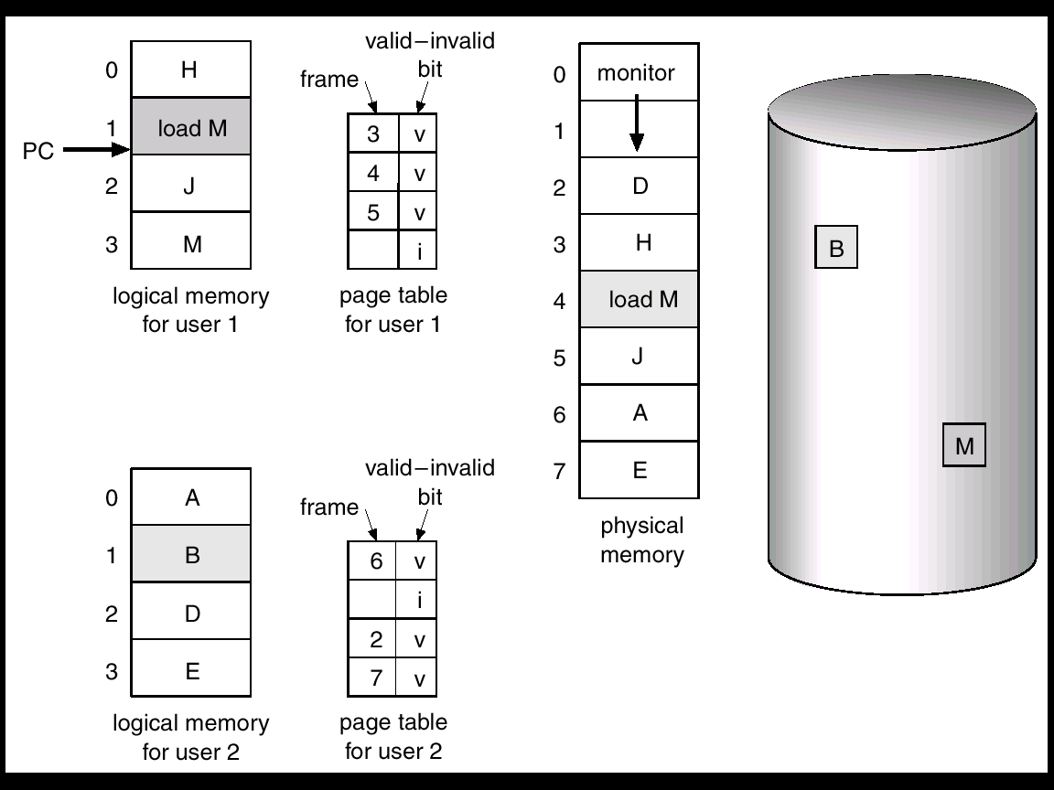
Page Replacement (Cont.)
generate a
reference to
page 3
not in
the memory
memory
full
Notes:
Need for page replacement

Slide 15
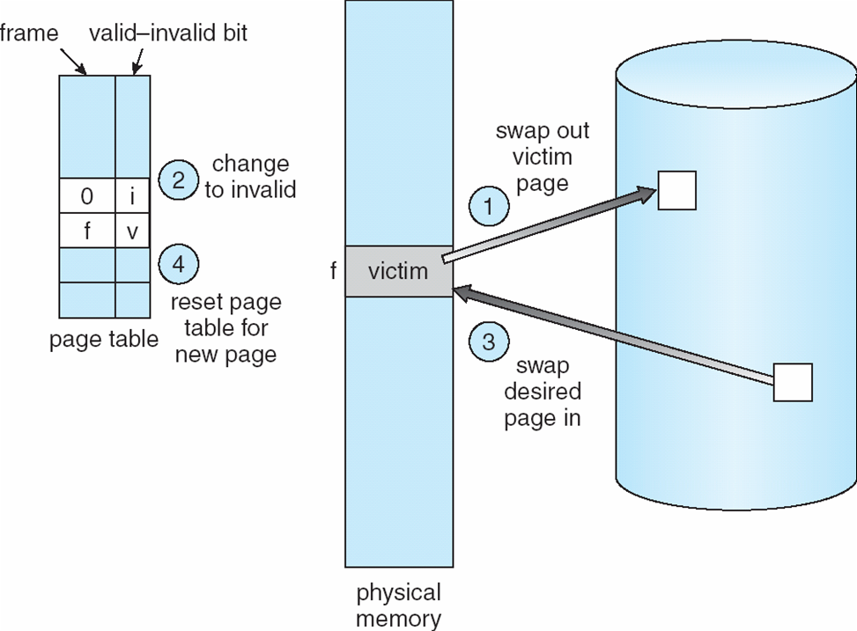
Page Replacement (Cont.)
Find a victim page using place replacement algorithm and write the victim page to the backing store (page-out for dirty page)
Change the page table entry of the victim page to invalid
Bring the desired page into the newly freed frame (page-in)
Update the page table entry for the new page
page
out
page
in
Why?
Notes:
Different from swap-in and swap-out
Step 2: avoid other process to access it.

Slide 16
Page Replacement (Cont.)
This overhead can be minimized by not writing pages that have not been modified since they were brought into memory. Such pages are identified by using a modify (or dirty) bit
When replacing pages, only dirty pages are actually written to backing store
Page replacement completes separation between logical memory and physical memory - large virtual memory can be provided on a smaller physical memory

Slide 17
Page-Replacement Algorithms
Objective is to have an algorithm with lowest page-fault rate
Evaluate algorithm by running it on a particular string of memory references (reference string), counting the number of page faults
In all our examples, the ref. string used is
1, 2, 3, 4, 1, 2, 5, 1, 2, 3, 4, 5

Slide 18

Page-Replacement Algorithms (Cont.)
Obviously, as the # of available frames increases, the # of page faults will decrease.
However, there are exceptions!
Notes:
For the same reference string.

Slide 19
Outline
First-In-First-Out (FIFO) Algorithm
Optimal Algorithm
Least Recently Used (LRU) Algorithm
Second-Chance Algorithm
Clock Algorithm

Slide 20
First-In-First-Out (FIFO) Algorithm
The easiest and simplest algorithm.
Example using 3 free frames:
Replace the page that has been loaded in the
memory for the longest period of time
1
2
3
4
1
2
5
1
2
3
4
5
F1
1
1
1
4
4
4
5
5
5
5
5
5
F2
2
2
2
1
1
1
1
1
3
3
3
F3
3
3
3
2
2
2
2
2
4
4
P
P
P
P
P
P
P
P
P
9 page faults

Slide 21
FIFO Algorithm (Cont.)
  Example using 4 free frames:
1
2
3
4
1
2
5
1
2
3
4
5
F1
1
1
1
1
1
1
5
5
5
5
4
4
F2
2
2
2
2
2
2
1
1
1
1
5
F3
3
3
3
3
3
3
2
2
2
2
F4
4
4
4
4
4
4
3
3
3
P
P
P
P
P
P
P
P
P
P
10 page faults !
Belady’s Anomaly
  more frames ⇒ fewer page faults

Slide 22
Optimal Algorithm
Replace the page that will not be used for the longest period of time.
1
2
3
4
1
2
5
1
2
3
4
5
F1
1
1
1
1
1
1
1
1
1
1
4
4
F2
2
2
2
2
2
2
2
2
2
2
2
F3
3
3
3
3
3
3
3
3
3
3
F4
4
4
4
5
5
5
5
5
5
P
P
P
P
P
P
6 page faults
Problem: How will the OS know the future references?

Slide 23
Optimal Algorithm (Cont.)
Theoretically best but practically infeasible
Used as a benchmark to measure how well other algorithms perform
Does not suffer from Belady’s anomaly: Add a frame ⇒ more look-ahead ⇒ Inclusion property : Pages loaded in n frames is always a subset of pages in n+1 frames

Slide 24
Least Recently Used (LRU) Algorithm
Replace the page that has not been used for the longest period of time
1
2
3
4
1
2
5
1
2
3
4
5
F1
1
1
1
1
1
1
1
1
1
1
1
5
F2
2
2
2
2
2
2
2
2
2
2
2
F3
3
3
3
3
5
5
5
5
4
4
F4
4
4
4
4
4
4
3
3
3
P
P
P
P
P
P
P
P
8 page faults
Similar to Optimal Algorithm, but looking backward in time (and not susceptible to Belady’s anomaly)

Slide 25
Implementation of LRU Algorithm
Counter Implementation
  Each page table entry has a time-of-use field
  The CPU increments a logical clock for every memory reference
  Whenever a page is referenced, the value of the clock is copied to the time-of-use field of the page
  When a page fault occurs, the page with the smallest time-of-use value is kicked out

Slide 26
Implementation of LRU Algorithm (Cont.)
Stack implementation
  Keep a stack of page numbers in a doubly linked list
  When a page is referenced:
    move it to the top
    the bottom of the stack is the LRU page
  List update is expensive, but no search is needed for page replacement

Slide 27
Implementation of LRU Algorithm (Cont.)
Stack Implementation Example
1
2
3
4
1
2
5
1
2
3
4
5
1
2
3
4
1
2
5
1
2
3
4
5
1
2
3
4
1
2
5
1
2
3
4
1
2
3
4
1
2
5
1
2
3
1
2
3
4
4
4
5
1
2
3
4
5
1
P
P
P
P
P
P
P
P
8 Page Faults
Stack of Page
Numbers

Slide 28
LRU Approximation Algorithms
Hardware support necessary for exact algorithms are expensive and generally not available
However, many systems support a hardware settable reference bit
  With each page associate a bit R, initially = 0
  When page is referenced, hardware sets its R to 1
  Replace page with R = 0 (if one exists). Note that the exact order of use cannot be determined by R
    There may be many pages with R = 1
Approximation Algorithm:
  Second-Chance (Clock) algorithm

Slide 29
Second-Chance Algorithm
A variation of FIFO algorithm
Choose oldest page as candidate to be replaced
If the reference bit R of the candidate is set (R=1), the page is given a second chance:
  the R bit is cleared and the page is treated as if it has just been read in
Otherwise, the page is kicked out

Slide 30
Clock Algorithm
Implementation of the Second-Chance algorithm
The clock hand points to the oldest page
When a page fault occurs, the page being pointed by the hand is inspected
If R bit is set, it is cleared and the hand is advanced to the next page
Otherwise, the page is evicted and new page is inserted into its place. The hand is advanced one position
In the worst case, when all the bits are set, the hand cycles through the whole queue, giving each page a second chance. In this case it degenerates to FIFO replacement

Slide 31
Clock Algorithm (Cont.)
0
0
1
0
1
1
1
0
newer
1
0
0
1

Slide 32
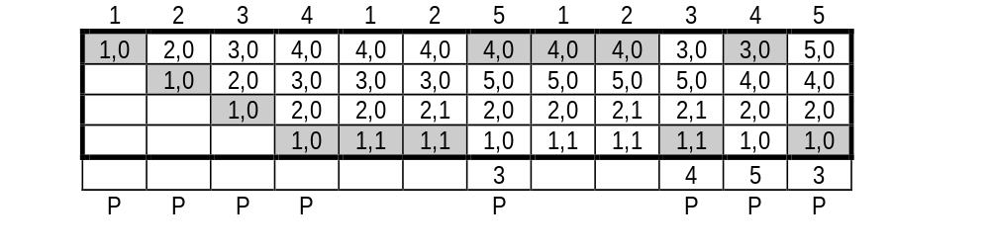
Example: Clock Algorithm
8 Page Faults
Circular List of Page
Numbers
The second digit of each entry is the R bit. The shaded entry is where the clock hand points to. It moves upwards. When reaching the top, it will go back to the bottom

Slide 33
Allocation of Frames
The OS must decide how many pages to bring into main memory
  the smaller the amount of memory allocated to each process, the more processes can reside in memory
  small number of pages loaded increases page faults
  beyond a certain size, further allocations of pages will not effect the page fault rate
Notes:
With paged virtual memory, it is not necessary and indeed may not be possible to bring all of the pages of a process into main memory to prepare it for execution. Thus, the operating system must decide how many pages to bring in, that is, how much main memory to allocate to a particular process. Several
factors come into play:
• The smaller the amount of memory allocated to a process, the more processes that can reside in main memory at any one time. This increases the probability that the operating system will find at least one ready process at any given time and hence reduces the time lost due to swapping.
• If a relatively small number of pages of a process are in main memory, then, despite the principle of locality, the rate of page faults will be rather high.
• Beyond a certain size, additional allocation of main memory to a particular process will have no noticeable effect on the page fault rate for that process
because of the principle of locality.

Slide 34
Fixed vs. Variable Allocation
Fixed Allocation
  gives a process a fixed number of frames in main memory within which to execute
    e.g., equal allocation or proportional allocation
  when a page fault occurs, one of the pages of that process must be replaced
Variable Allocation
  allows the number of page frames allocated to a process to be varied over the lifetime of the process
Notes:
With these factors in mind, two sorts of policies are to be found in contemporary operating systems. A fixed-allocation policy gives a process a fixed number of frames in main memory within which to execute. That number is decided at initial load time (process creation time) and may be determined based on the type of process (interactive, batch, type of application) or may be based on guidance from the programmer or system manager. With a fixed-allocation policy, whenever a page fault occurs in the execution of a process, one of the pages of that process must be replaced by the needed page.
A variable-allocation policy allows the number of page frames allocated to a process to be varied over the lifetime of the process. Ideally, a process that is suffering persistently high levels of page faults, indicating that the principle of locality only holds in a weak form for that process, will be given additional page frames to reduce the page fault rate; whereas a process with an exceptionally low page fault rate, indicating that the process is quite well behaved from a locality point of view, will be given a reduced allocation, with the hope that this will not noticeably increase the page fault rate. The use of a variable-allocation policy relates to the concept of replacement scope, as explained in the next subsection.
The variable-allocation policy would appear to be the more powerful one. However, the difficulty with this approach is that it requires the operating system to
assess the behavior of active processes. This inevitably requires software overhead in the operating system and is dependent on hardware mechanisms provided by the processor platform.

Slide 35
Global vs. Local Allocation
Global replacement – process selects a replacement frame from the set of all frames; one process can take a frame from another process
  ⇒ Performance depends on external circumstances (other processes)
Local replacement – each process selects only from its own set of allocated frame
  ⇒ may hinder other processes by not making available its less used pages/frames
Notes:
The scope of a replacement strategy can be categorized as global or local. Both types of policies are activated by a page fault when there are no free page frames.
A local replacement policy chooses only among the resident pages of the process that generated the page fault in selecting a page to replace.
A global replacement policy considers all unlocked pages in main memory as candidates for replacement, regardless of which process owns a particular page.
While it happens that local policies are easier to analyze, there is no convincing evidence that they perform better than global policies, which are attractive because of their simplicity of implementation and minimal overhead [CARR84, MAEK87].

Slide 36
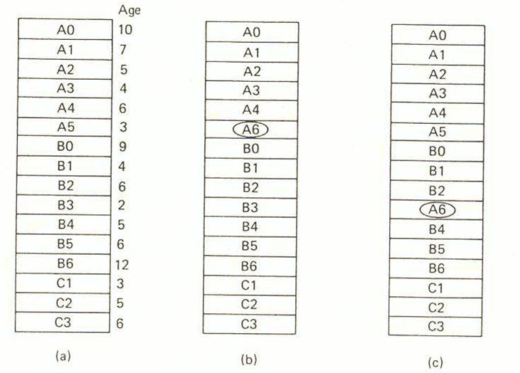
Global vs. Local Allocation (Cont.)
Time Last
Accessed
Process A generates a reference to page A6
original
configuration
local
replacement
global
replacement

Slide 37
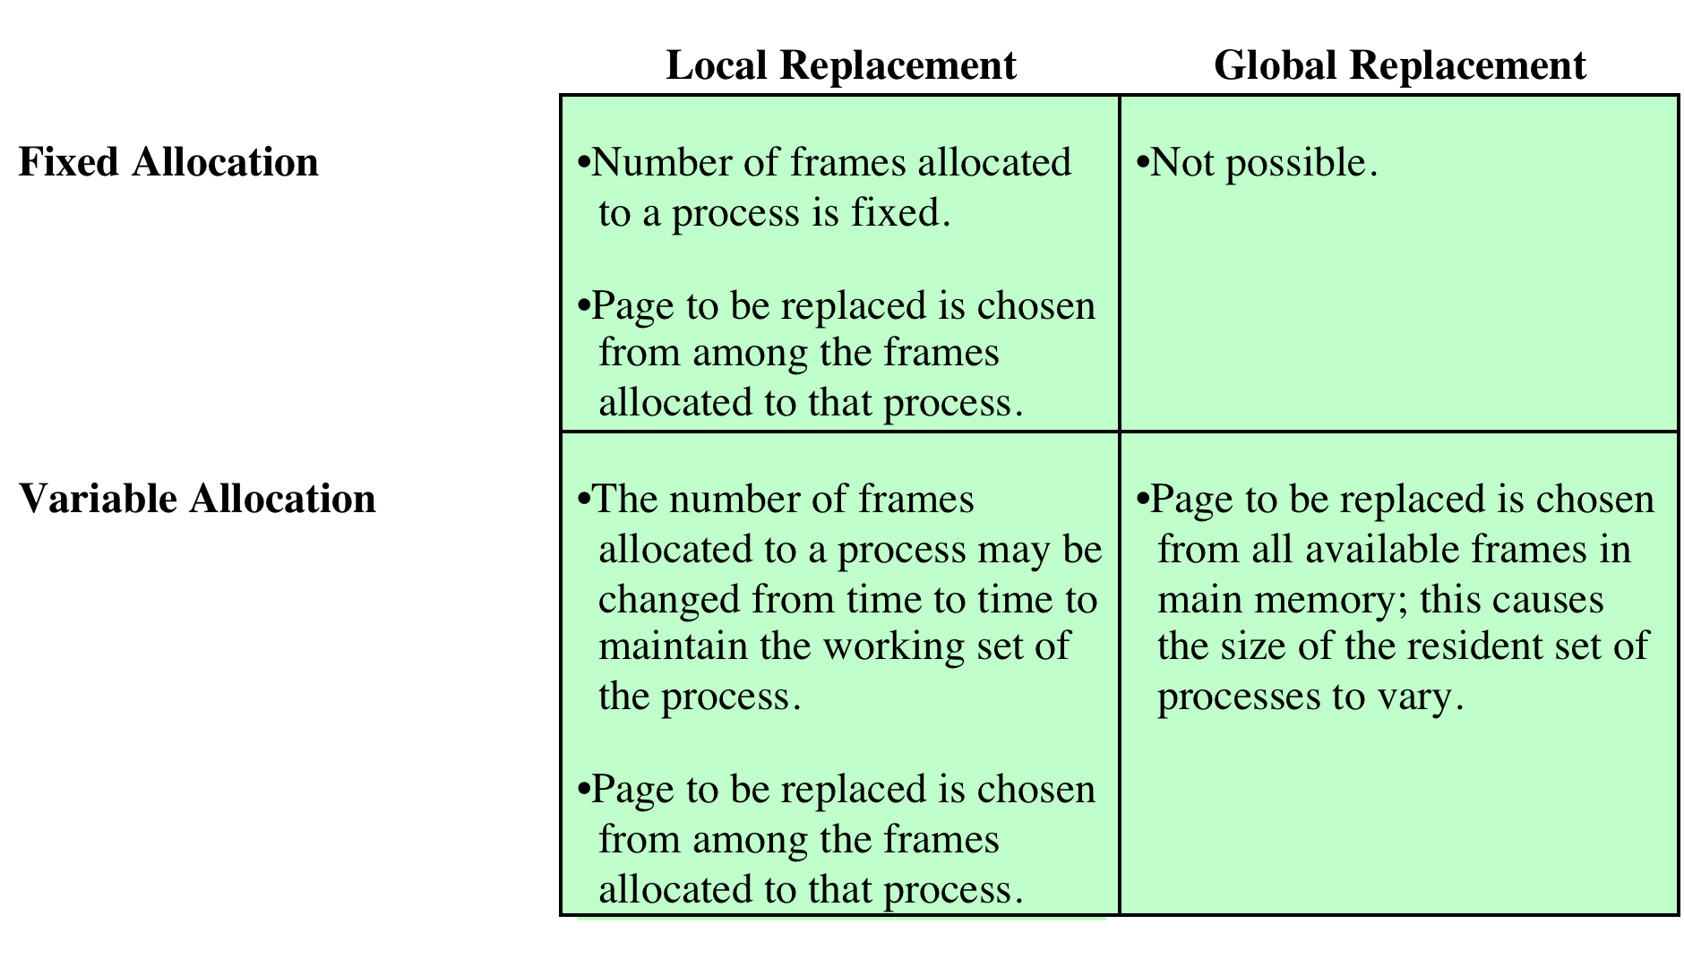
Allocation of Frames – Summary
Notes:
There is a correlation between replacement scope and resident set size.
A fixed resident set implies a local replacement policy: To hold the size of a resident set fixed, a page that is removed from main memory must be replaced by another page from the same process.
A variable-allocation policy can clearly employ a global replacement policy: The replacement of a page from one process in main memory with that of another causes the allocation of one process to grow by one page and that of the other to shrink by one page.
With a fixed-allocation policy, it is necessary to decide ahead of time the amount of allocation to give to a process. This could be decided on the basis of the type of application and the amount requested by the program. The drawback to this approach is twofold: If allocations tend to be too small, then there will be a high page fault rate, causing the entire multiprogramming system to run slowly. If allocations tend to be unnecessarily large, then there will be too few programs in main memory and there will be either considerable processor idle time or considerable time spent in swapping.
The variable-allocation, local-scope strategy attempts to overcome the problems with a global-scope strategy. It can be summarized as follows:
1. When a new process is loaded into main memory, allocate to it a certain number of page frames as its resident set, based on application type, program
request, or other criteria. Use either prepaging or demand paging to fill up the allocation.
2. When a page fault occurs, select the page to replace from among the resident set of the process that suffers the fault.
3. From time to time, reevaluate the allocation provided to the process, and increase or decrease it to improve overall performance.
With this strategy, the decision to increase or decrease a resident set size is a deliberate one and is based on an assessment of the likely future demands of active processes. Because of this evaluation, such a strategy is more complex than a simple global replacement policy. However, it may yield better performance. The key elements of the variable-allocation, local-scope strategy are the criteria used to determine resident set size and the timing of changes. One specific strategy that has received much attention in the literature is known as the working set strategy .
The variable-allocation, global-scope perhaps the easiest to implement and has been adopted in a number of operating systems. At any given time, there are a number of processes in main memory, each with a certain number of frames allocated to it. Typically, the operating system also maintains a list of free frames. When a page fault occurs, a free frame is added to the resident set of a process and the page is brought in. Thus, a process experiencing page faults will gradually grow in size, which should help reduce overall page faults in the system.
The difficulty with this approach is in the replacement choice. When there are no free frames available, the operating system must choose a page currently in
memory to replace. The selection is made from among all of the frames in memory, except for locked frames such as those of the kernel. Using any of the policies discussed in the preceding subsection, the page selected for replacement can belong to any of the resident processes; there is no discipline to determine which process should lose a page from its resident set. Therefore, the process that suffers the reduction in resident set size may not be optimum.

Slide 38
Thrashing
If a process does not have “enough” pages, the page-fault rate is very high. This leads to:
  Low CPU utilization
  OS thinks that it needs to increase the degree of multiprogramming
  Another process is added to the system
  CPU utilization drops further

Slide 39
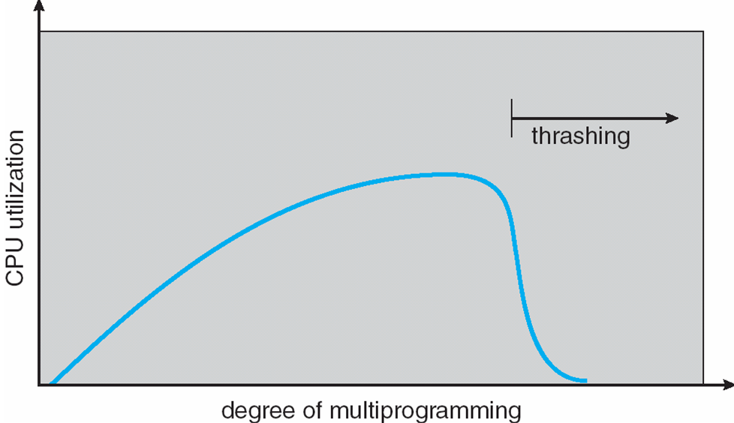
Thrashing (Cont.)
Thrashing ≡ a process is busy bringing pages in and out (no work is being done)
Notes:
In the steady state, practically all of main memory will be occupied with process pieces, so that the processor and operating system have direct access to as many processes as possible. But, when memory is full, to bring in a page the operating system must throw out another page . If it throws out a page just before it is used, then it will just have to go get that page again almost immediately. Too much of this leads to a condition known as thrashing : The system spends most of its time paging-in and out rather than executing instructions. The avoidance of thrashing was a major research area in the 1970s and led to a variety of complex but effective algorithms. In essence, the operating system tries to guess, based on recent history, which pieces are least likely to be used in the near future.
As the multiprogramming level increases from a small value, one would expect to see processor utilization rise, because there is less chance that all resident processes are blocked. However, a point is reached at which the average resident set is inadequate. At this point, the number of page faults rises dramatically, and processor utilization collapses.

Slide 40
Strategies to combat Thrashing
Two approaches are used:
  Working-Set Model
  Page-Fault Frequency

Slide 41
Working-Set Model
Locality of Reference: Processes tend to refer to pages in a localised manner
  Temporal Locality: locations referred to just before are likely to be referred to again (i.e., location references are clustered over time)
  Spatial Locality: code & data are usually clustered physically
This observation led to the Working-Set Model
Notes:
Except for branch and procedure/function calls, program execution is sequential. Hence, in most cases the next instruction to be fetched immediately follows the last instruction fetched.
It is rare to have a long chain of nested procedure/function invocations. Rather, a program confined to a rather narrow window of procedure-invocation depth. Thus, over a short period of time references to instructions tend to be localized to a few procedures.
Most of iterative constructs consist of a relatively small number of instructions repeated many times. For the duration of iteration, computation is therefore confined to a small contiguous portion of a program.
In many programs, much of the computation involves processing data structures, such as arrays or sequences of records. In many cases, successive references to these data structures require access to closely located data items.
The principle of locality states that program and data references within a process tend to cluster. Hence, the assumption that only a few pieces of a process will be needed over a short period of time is valid. Also, it should be possible to make intelligent guesses about which pieces of a process will be needed in the near future, which avoids thrashing.

Slide 42
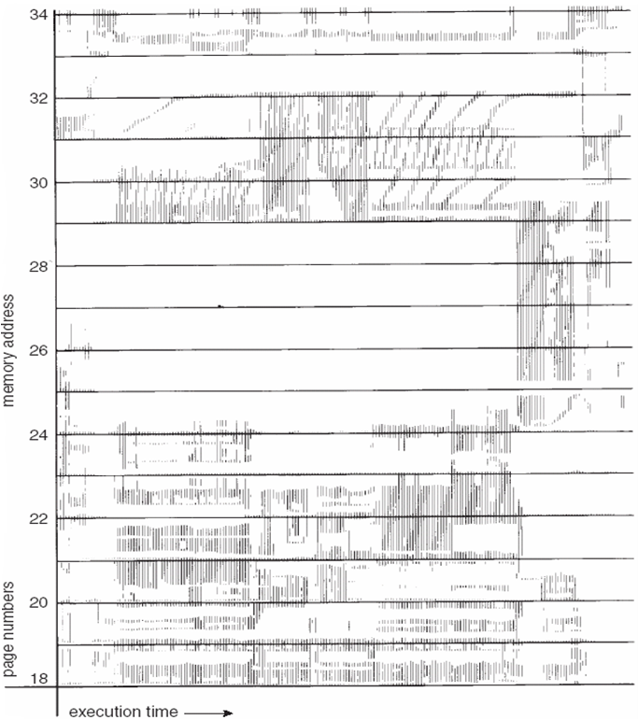
Working-Set Model (Cont.)
During the lifetime of the process, references are confined to a subset of pages
Notes:
One way to confirm the principle of locality is to look at the performance of processes in a virtual memory environment. The figure shown on this slide is a rather famous diagram that dramatically illustrates the principle of locality [HATF72]. Note that, during the lifetime of the process, references are confined to a subset of pages.

Slide 43
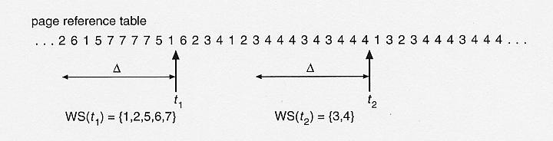
Working-Set Model (Cont.)
Δ ≡ working-set window ≡ a fixed number of page references
For example: if Δ= 10 memory references, then the working set at t₁ is {1,2,5,6,7}, at t₂ is {3,4}

Slide 44
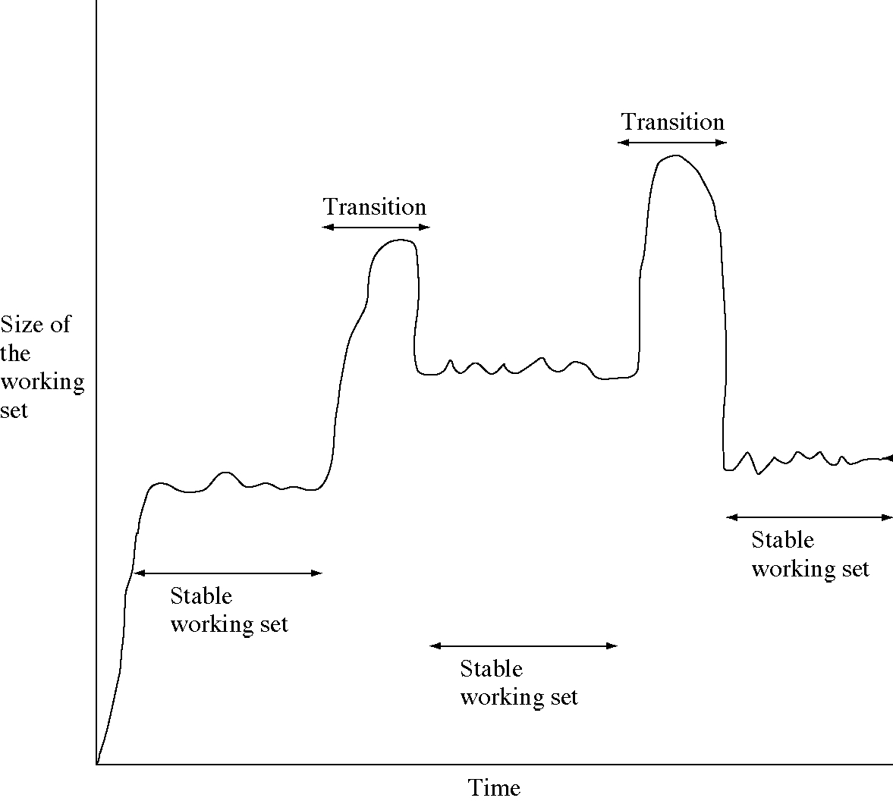
Working-Set Model (Cont.)
Notes:
Size of working set may change over time.
At a certain locality, if the working set of a process is in memory there will be few page faults
As the process moves to next locality, a new working set will be built up through a series of page faults

Slide 45
Working-Set Model (Cont.)
WSS_{i} (working set size of Process P_{i}) =
total number of pages referenced in the most recent Δ (varies in time)
D = Σ WSS_{i} ≡ total demand for frames
m = total # of frames
if D > m ⇒ Thrashing
Policy: if D > m, then suspend (i.e., swap out) one of the processes
Notes:
There are a number of problems associated with the working set model
The optimal value of Δ is unknown and in any case would vary during a process execution
If Δ too small, it will not encompass entire locality; and if Δ too large, it will encompass several localities

Slide 46

Page-Fault Frequency Scheme

Slide 47
Page-Fault Frequency Scheme (Cont.)
Establish “acceptable” page-fault rate
  If actual rate of a process is too low, remove a frame from that process
  If actual rate too high, give that process a frame
May have to suspend (i.e., swap out) a process if the page fault rate increases and no free frames are available
Notes:
Policies for swapping out processes:
• Lowest-priority process: This implements a scheduling policy decision and is unrelated to performance issues.
• Faulting process: The reasoning is that there is a greater probability that the faulting task does not have its working set resident, and performance would
suffer least by suspending it. In addition, this choice has an immediate payoff because it blocks a process that is about to be blocked anyway and it eliminates
the overhead of a page replacement and I/O operation.
• Last process activated: This is the process least likely to have its working set resident.
• Process with the smallest resident set: This will require the least future effort to reload. However, it penalizes programs with strong locality.
• Largest process: This obtains the most free frames in an overcommitted memory, making additional deactivations unlikely soon.
• Process with the largest remaining execution window: In most process scheduling schemes, a process may only run for a certain quantum of time before being interrupted and placed at the end of the Ready queue. This approximates a shortest-processing-time-first scheduling discipline.

Slide 48
Summary
Virtual Memory
  To allow a large logical address space to be mapped onto a smaller physical memory
  Demand paging is a way to implement virtual memory
Page Replacement Algorithms
  FIFO, Optimal, LRU, LRU Approximation
Frame Allocation
  Fixed vs. Dynamic Allocation
  Local vs. Global Allocation
Notes:
To use the processor and the I/O facilities efficiently, it is desirable to maintain as many processes in main memory as possible. In addition, it is desirable to free programmers from size restrictions in program development.
The way to address both of these concerns is virtual memory. With virtual memory, all address references are logical references that are translated at run time
to real addresses. This allows a process to be located anywhere in main memory and for that location to change over time. Virtual memory also allows a process to be broken up into pieces. These pieces need not be contiguously located in main memory during execution and, indeed, it is not even necessary for all of the pieces of the process to be in main memory during execution.
Design Issues: page replacement policies; frame allocation policies
Performance Issue: thrashing

Slide 49
Summary (Cont.)
Thrashing: process is busy bringing pages in and out (no work is being done)
  Working-set Model
  Page-Fault Frequency Scheme

